Slide 1
Playing With Cards by Nick Hattwick
Nicholas Hattwick https://github.com/nickhattwick/PlayingWithCards
(with mentor Nikhil Sharma) January 2017

Slide 2
The Plan
Step 1: Recreate Magic: the Gathering in Python
Step 2: Use Machine Learning to come up with the best strategy
Step 3: ???
Step 4: Profit

Slide 3
The Simplified Game
40 card decks
Land cards create “Mana” which is used to summon creatures
Creature cards can attack and Block
Goal is to take opponent’s Life Points from 20 to 0

Slide 4
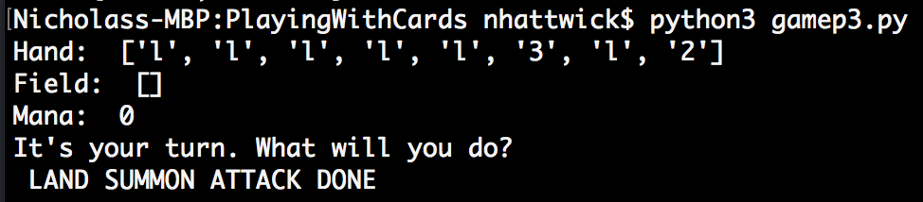
The Prototype

Slide 5
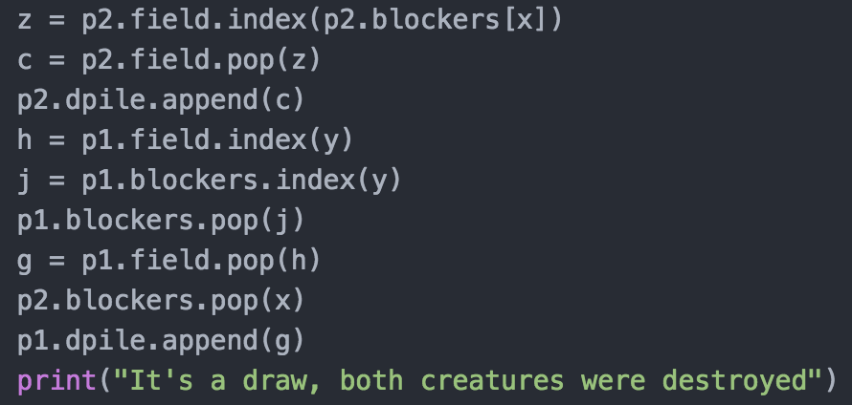
What even is this?

Slide 6
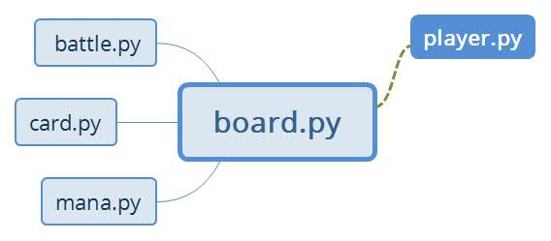
The Program

Slide 7
Polymorphism

Slide 8
Machine Learning Cycle
Computer Player uses knowledge base to determine moves
Game data is added to a log file
1
2
Rungame.py
Results.json
Knowledge base is updated
Parsed.json
CPU’s knowledge base is pulled back and combined with new data.
Parsing.py
4
3

Slide 9
Success?
Simplified Magic
Functional Logging System
Functional Updating Computer Strategy
Frame in place and easy to improve
Next steps:

Slide 10

Thank You!
Nikhil Sharma – Mentor and Developer
Ray Berg and ChiPy Mentorship Program
Austin Walker – Boston developer
Boston Python – special thanks to Eric Ma
Dr. Chuck! – Michigan Python certification programs
See you at Pycon!

